Slide 1
Hayley Housam
Apprenticeship Co-Ordinator

Slide 3
What are apprenticeships?
Earn a wage
Work for at least
30 hours per week
Study towards a
job related qualification
Contract of employment
including holiday pay
Real job with real responsibilities
Notes:
Lots of people get confused about apprenticeships. That’s probably because they’ve been around for hundreds of years, but they’ve changed a lot in that time.
You will earn a wage – and it can be a really good salary too! We’ll talk more about money later on.
You will work for at least 30 hours per week and this will include paid time to complete your studies.
The employer will invest their time and money in helping you to gain qualifications and valuable new skills and experience. You will be given real responsibilities and expected to work hard, just like anyone else in the company.
You will also be supported by a training provider, who will help you achieve your qualifications and make sure you complete your apprenticeship.
Because it’s a proper job, you will also have a contract of employment, including holiday pay - exactly the same as any other member of staff.
It’s important to understand that an apprenticeship is a real job, with a real employer. You will spend time working alongside other people and learn from their experience. There’s a myth that apprenticeships are just like work experience, where you’re given basic tasks or asked to make the tea, but this isn’t the case.
An apprenticeship typically takes 1 to 4 years to complete (sometimes up to 6 for some areas like Solicitor). The total duration will depend on the delivery model that your employer selects, the level and the subject you’re studying. As a minimum, all apprenticeships must last for a minimum of 12 months.
It’s important to remember that apprenticeships aren’t the ‘easy option’. Holding down a full time job and studying takes a certain skill, and it won’t be right for everyone.

Slide 5
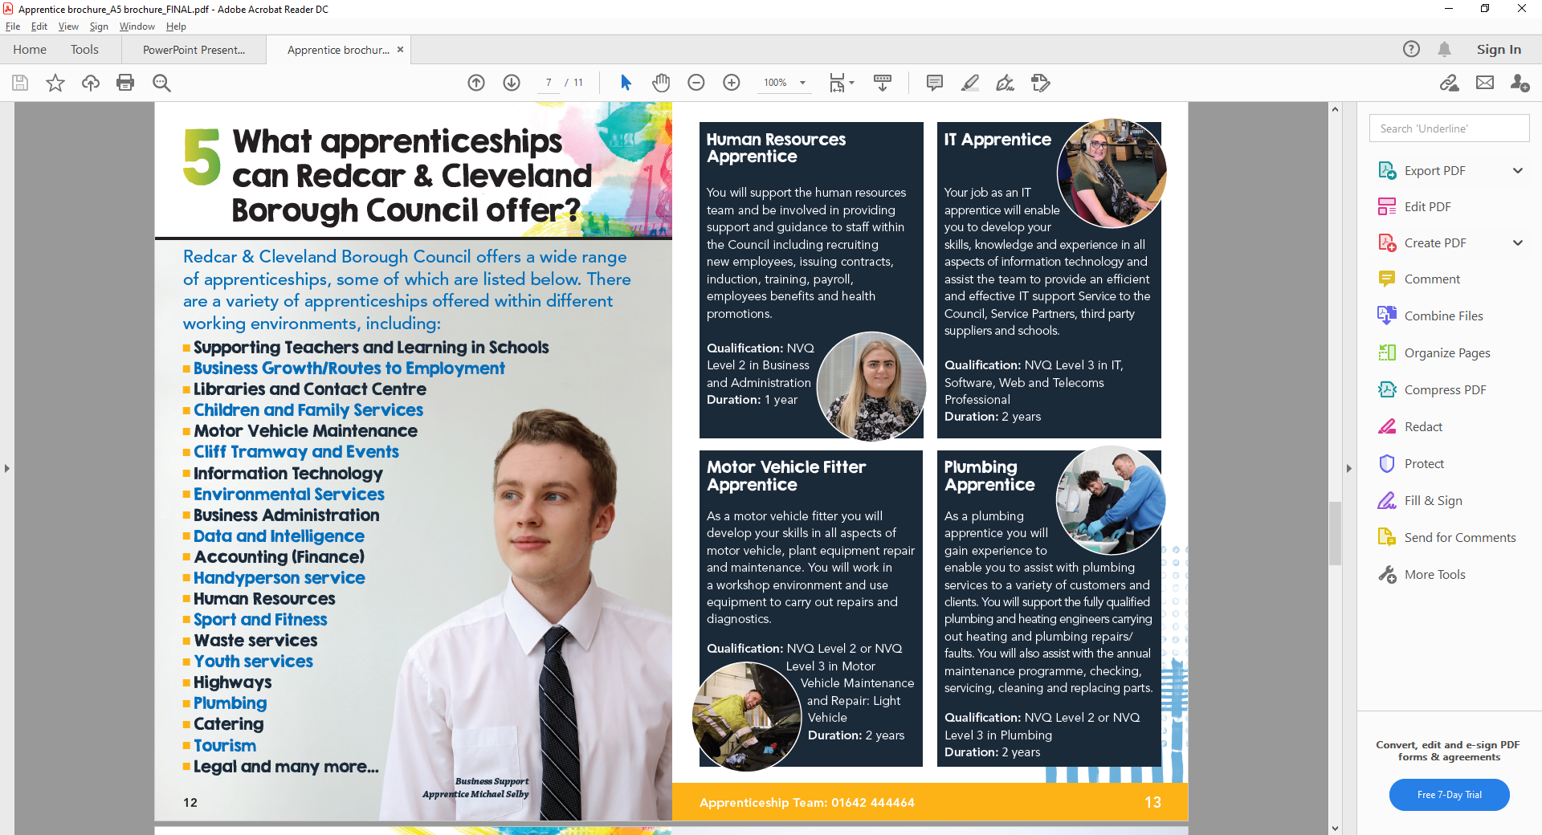

Slide 7
Notes:
There is a programme called a Traineeship
Traineeships are education and training programmes, run by colleges and training providers, that prepare young people aged 16 to 24 to progress onto an apprenticeship, employment or further learning like a college course
They are made up of three main parts:
English and maths support (if you need it)
Employability skills and
Work experience with a local employer
Traineeships can last anywhere between 6 weeks and 12 months, depending on how the training provider best feels the course can support you
Typically however, they tend to last less than 6 months
The Government have recently announced that they will provide £1,000 to employers for every traineeship they offer, and they will triple the number of places available for young people to be able to start a traineeship, hopefully providing more opportunities for you

Slide 8
What is a traineeship?
16 to 24
Notes:
There is a programme called a Traineeship
Traineeships are education and training programmes, run by colleges and training providers, that prepare young people aged 16 to 24 to progress onto an apprenticeship, employment or further learning like a college course
They are made up of three main parts:
English and maths support (if you need it)
Employability skills and
Work experience with a local employer
Traineeships can last anywhere between 6 weeks and 12 months, depending on how the training provider best feels the course can support you
Typically however, they tend to last less than 6 months
The Government have recently announced that they will provide £1,000 to employers for every traineeship they offer, and they will triple the number of places available for young people to be able to start a traineeship, hopefully providing more opportunities for you

Slide 9
Where to look?
Website
www.redcar-Cleveland.gov.uk/
apprenticeships
Social media
Facebook.com/redcarcleveland
Instagram.com/redcarcleveland
WHERE ELSE TO LOOK?
Your friends and family
+
https://www.gov.uk/find-traineeship
https://www.gov.uk/find-apprenticeship
www.north-eastjobs.org.uk
How to Apply
Application Form
Shortlisting
Interview
Notes:
Whilst Find an apprenticeship is a great place to start looking for apprenticeships, it is not the only place.
If you have a particular employer in mind, visit their website and see if you can sign up for recruitment alerts or if they send out a newsletter.
Make sure you follow their careers pages on social media using Facebook, Twitter and Instagram too as they will probably use this as a way to promote their vacancies.
This will be even more important for staying on top of alerts and updates about recruitment whilst the impact of the Coronavirus pandemic is ongoing. Employers will be using these platforms to update potential applicants.
We have spoken to lots of apprentices and quite often, they will say that they actually heard about their job through a family member or friend. So make sure you tell everyone you can think of that you’re looking for an apprenticeship and you never know what might come through!
There are lots of other job search sites out there, including Vacancy Snapshot where you can flick through online interactive profiles for some of the UK’s top apprentice employers
Definitely spend some time looking into the different types of employers. There will be a real mix from your local council who might have a jobs page for young people, through to bigger recruitment sites too.

Slide 11
Notes:
Do you have any questions?
Presenter notes
Virtual – remember to encourage individuals to use the chat facility if they would like to ask a question but would not like to be unmuted
Activity idea: Face to face - Offer a small box of chocolates / packet of sweets for whoever has the best question

